Slide 1

a) Title of the Project
A Multi-purpose
Website & App
A Multi-purpose
Website & App
Team Members /Authors :
S Gopi Chandu (420237)
M Anjani Kumar (420203)
SECTION B , GROUP NO : 17
Team Members /Authors :
S Gopi Chandu (420237)
M Anjani Kumar (420203)
SECTION B , GROUP NO : 17
Mentor :
Mr K Suman
Mentor :
Mr K Suman

Slide 2

b) Problem statement.
Problem Statement :
Every Day a person requires a lot of things like a Calculator ,BMI (related to health), and some useful mathematical tools in life to solve typical tasks in life synchronously

Slide 3
C) Objectives of the project.
Objectives :
To solve typical problems of people in daily life
To make things simple by accessing our website or App.
To give access to such typical problem solving tools *.

Slide 4
D) Proposed method
Proposed method :
To build a Website and App with the requisite tools to solve recurring simple tasks in life like counting, calculating BMI ,Currency converter some unit conversions that we use calculate daily, and solve the problem. (or) Find any simple mathematical techniques to solve them in seconds

Slide 5
E ) Experimental Setup
Experimental Setup :
- We used Android Studio , VS Code, Android Emulator, Web browser to code our website and app.

Slide 6
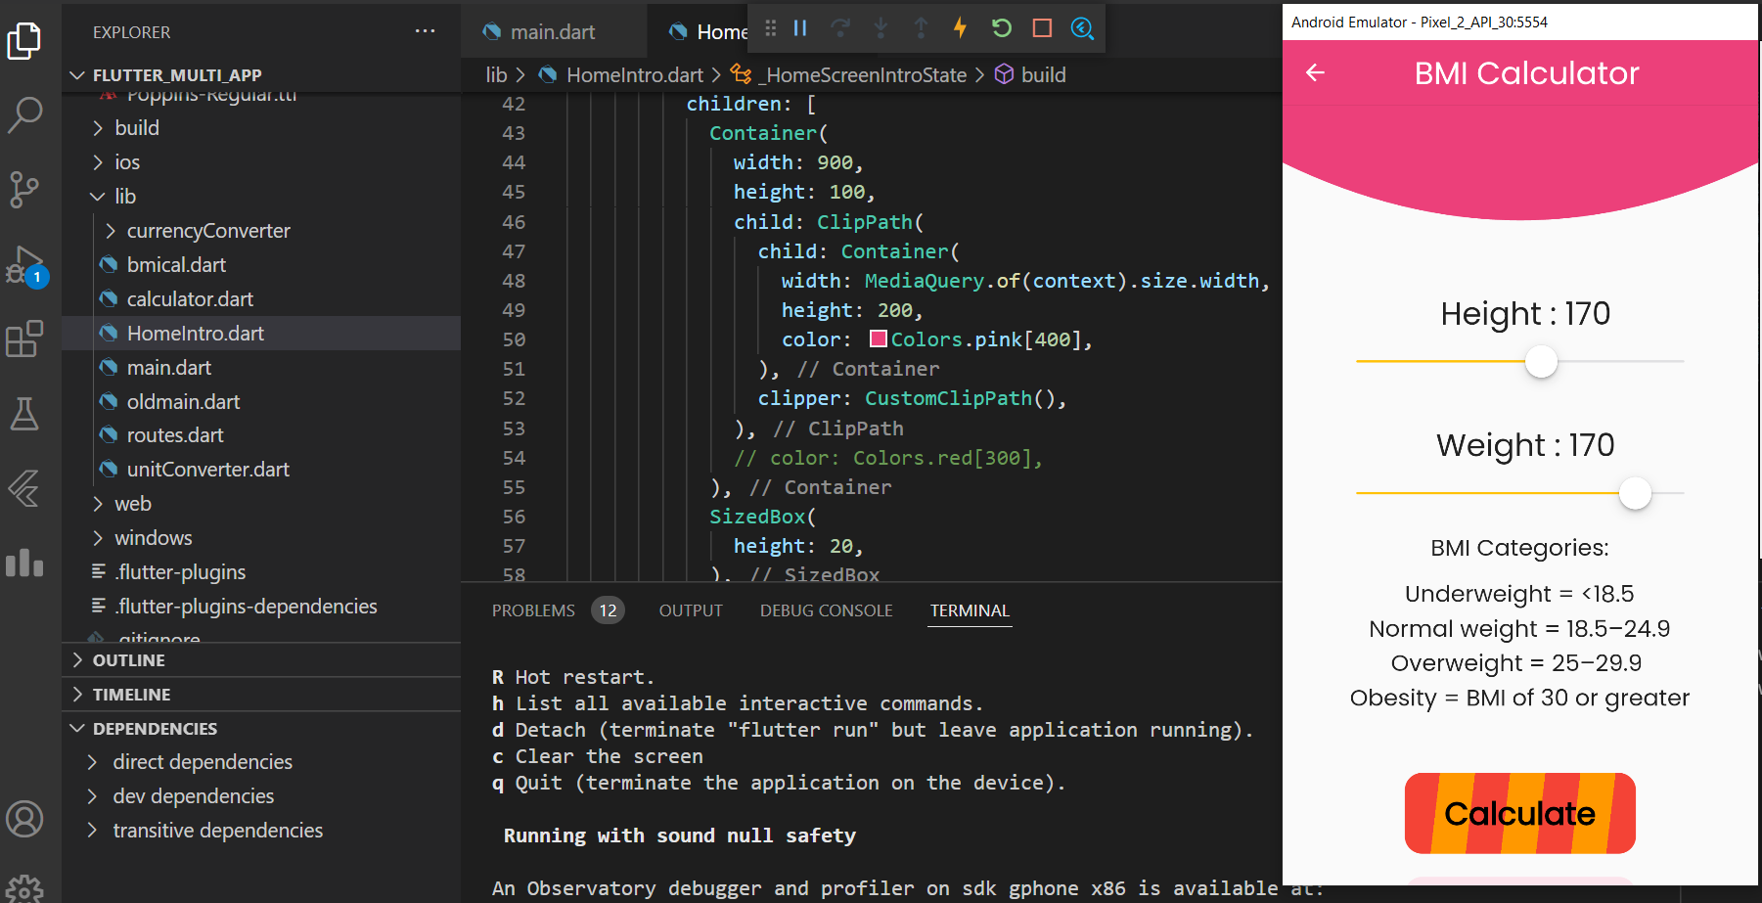
E ) Experimental Setup

Slide 7
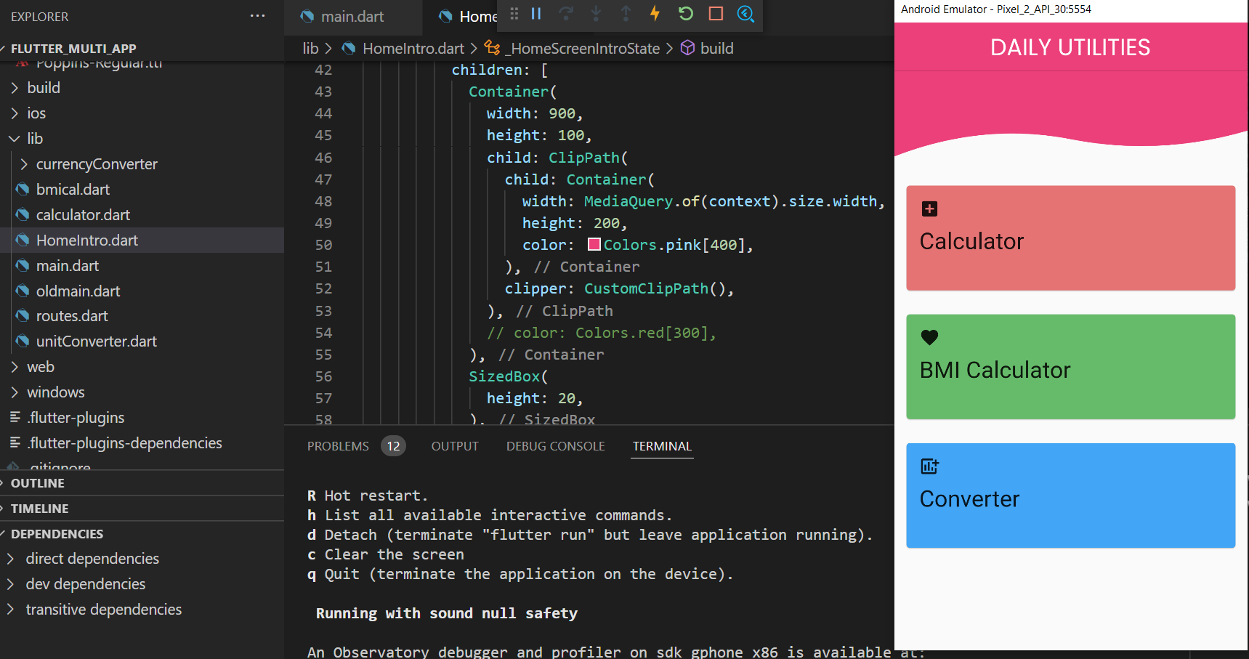
E ) Experimental Setup

Slide 8
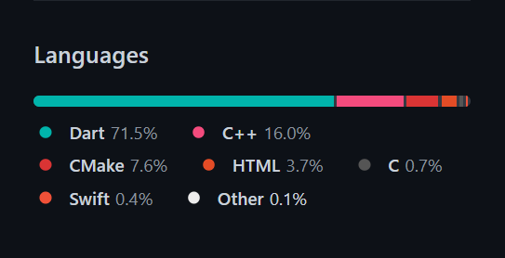
F ) Results (as tables/graphs/charts)
Results:
Succesfully made a website and an App to solve the Daily useful calculations.

Slide 9
G ) Novelty/Uniqueness of the work done
Bringing a lot of useful things together into a single app makes it so portable ,easy and simple to use. Most of the major companies have started with single feature and have expanded their apps into vast downpour of new features, We do this as well as the other way , by bringing together a group of related tools.

Slide 10
H) Future directions
Adding more complex and simple mathematical problem solving tools which may someday become essential for People.

Slide 11
I) References
References:
Bootstrap Documentation
Flutter Documentation

Slide 12
J) Code in Git Hub
Git hub Links
https://github.com/gopi-chandu/EPICS-project-App
https://github.com/MajetiAnjaniKumar/BasicMathTools

Slide 13
Next 6 slides contains the screenshots of the website and later a video is present to demonstrate the functionality of our website and App

Slide 14
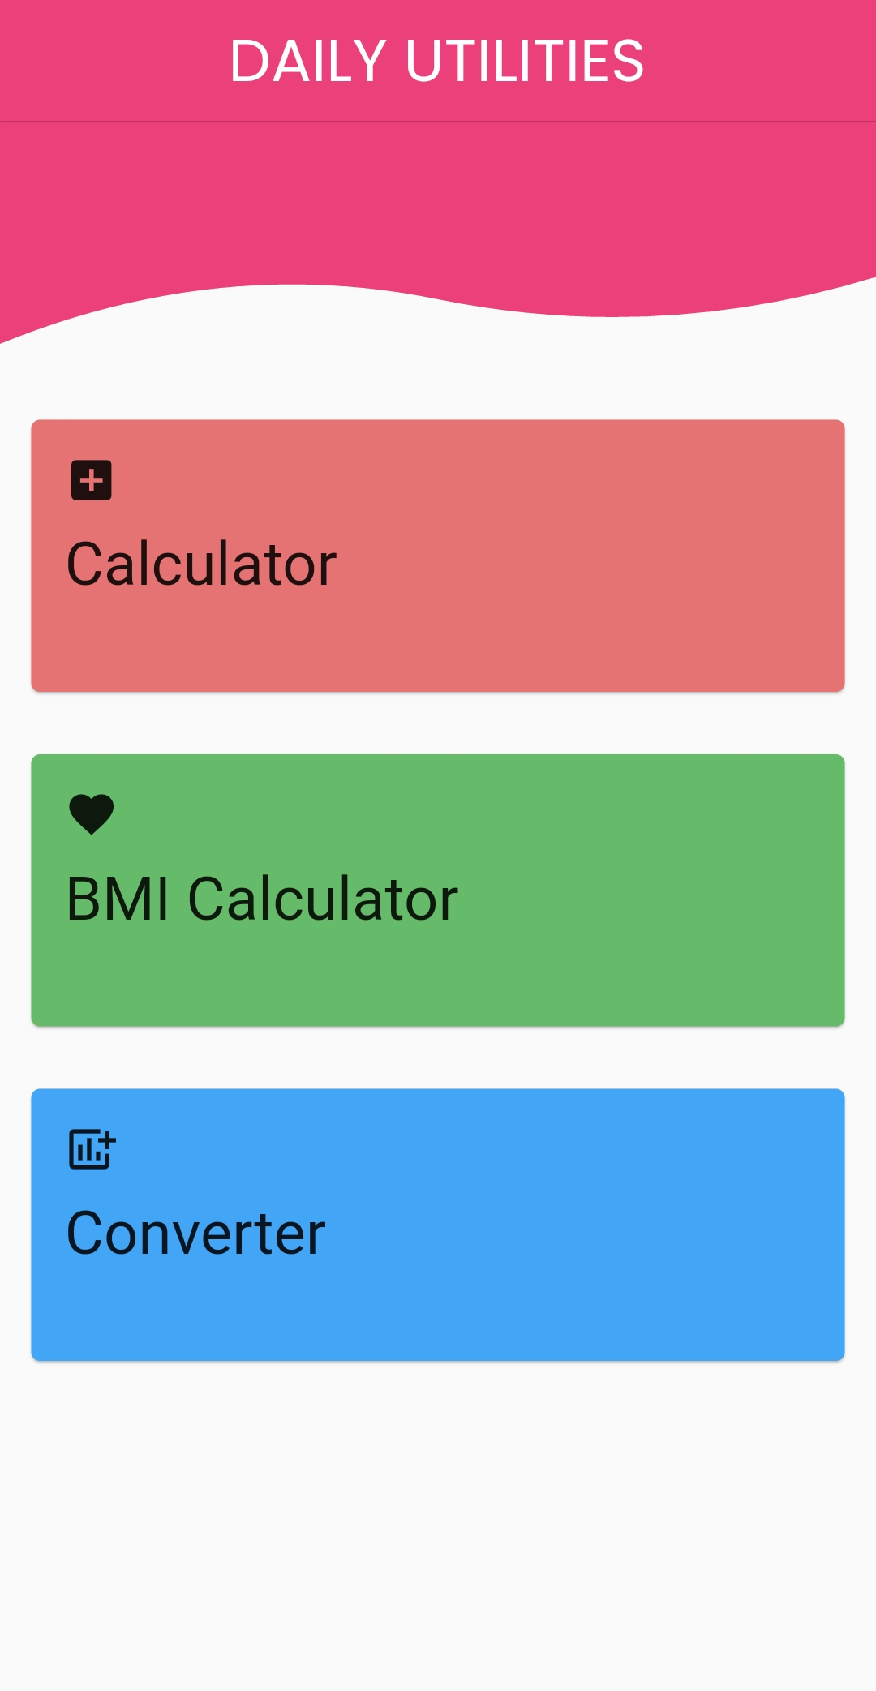
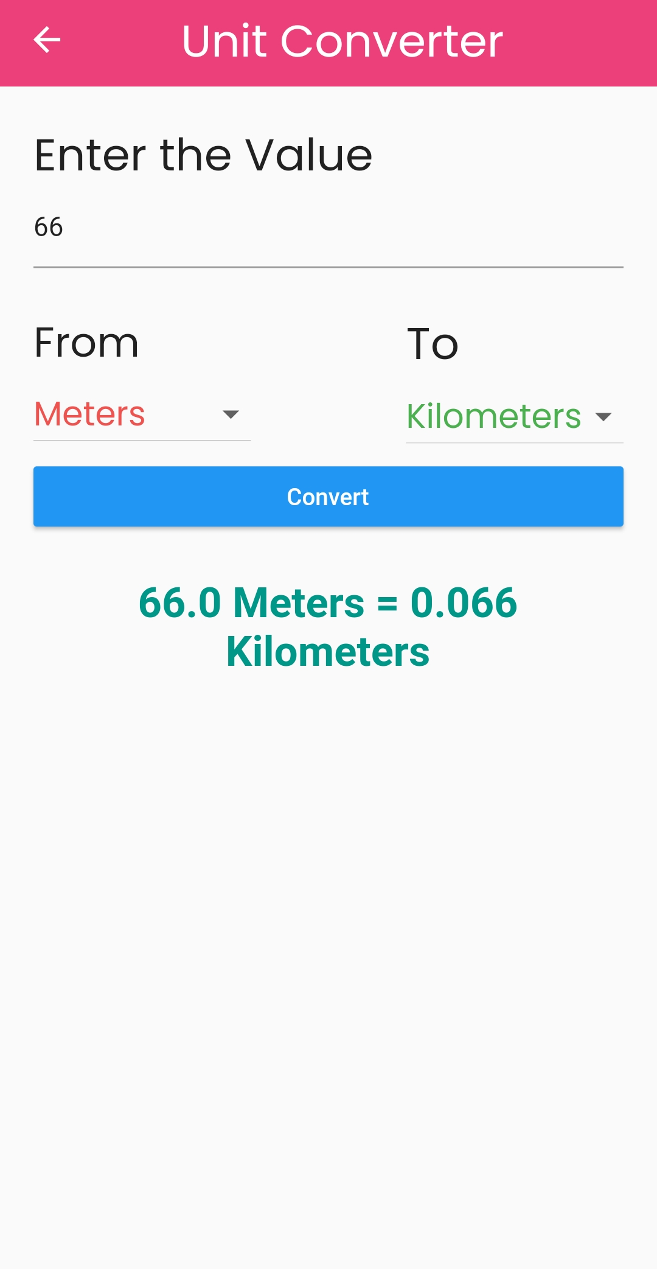
Screenshot - 1

Slide 15
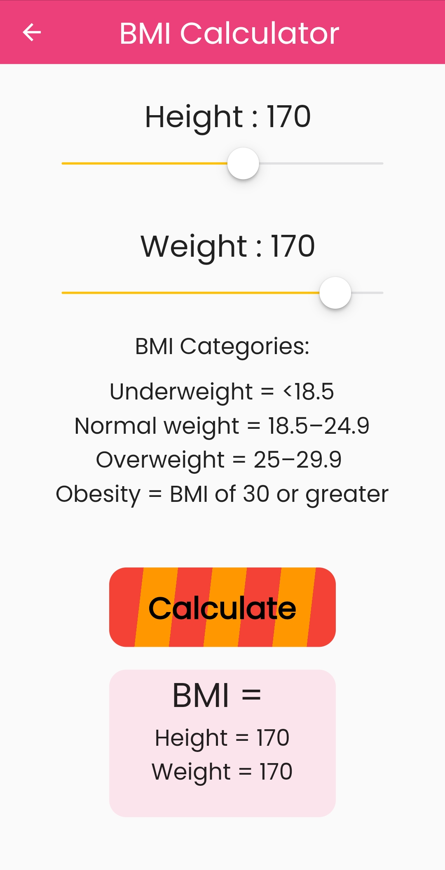
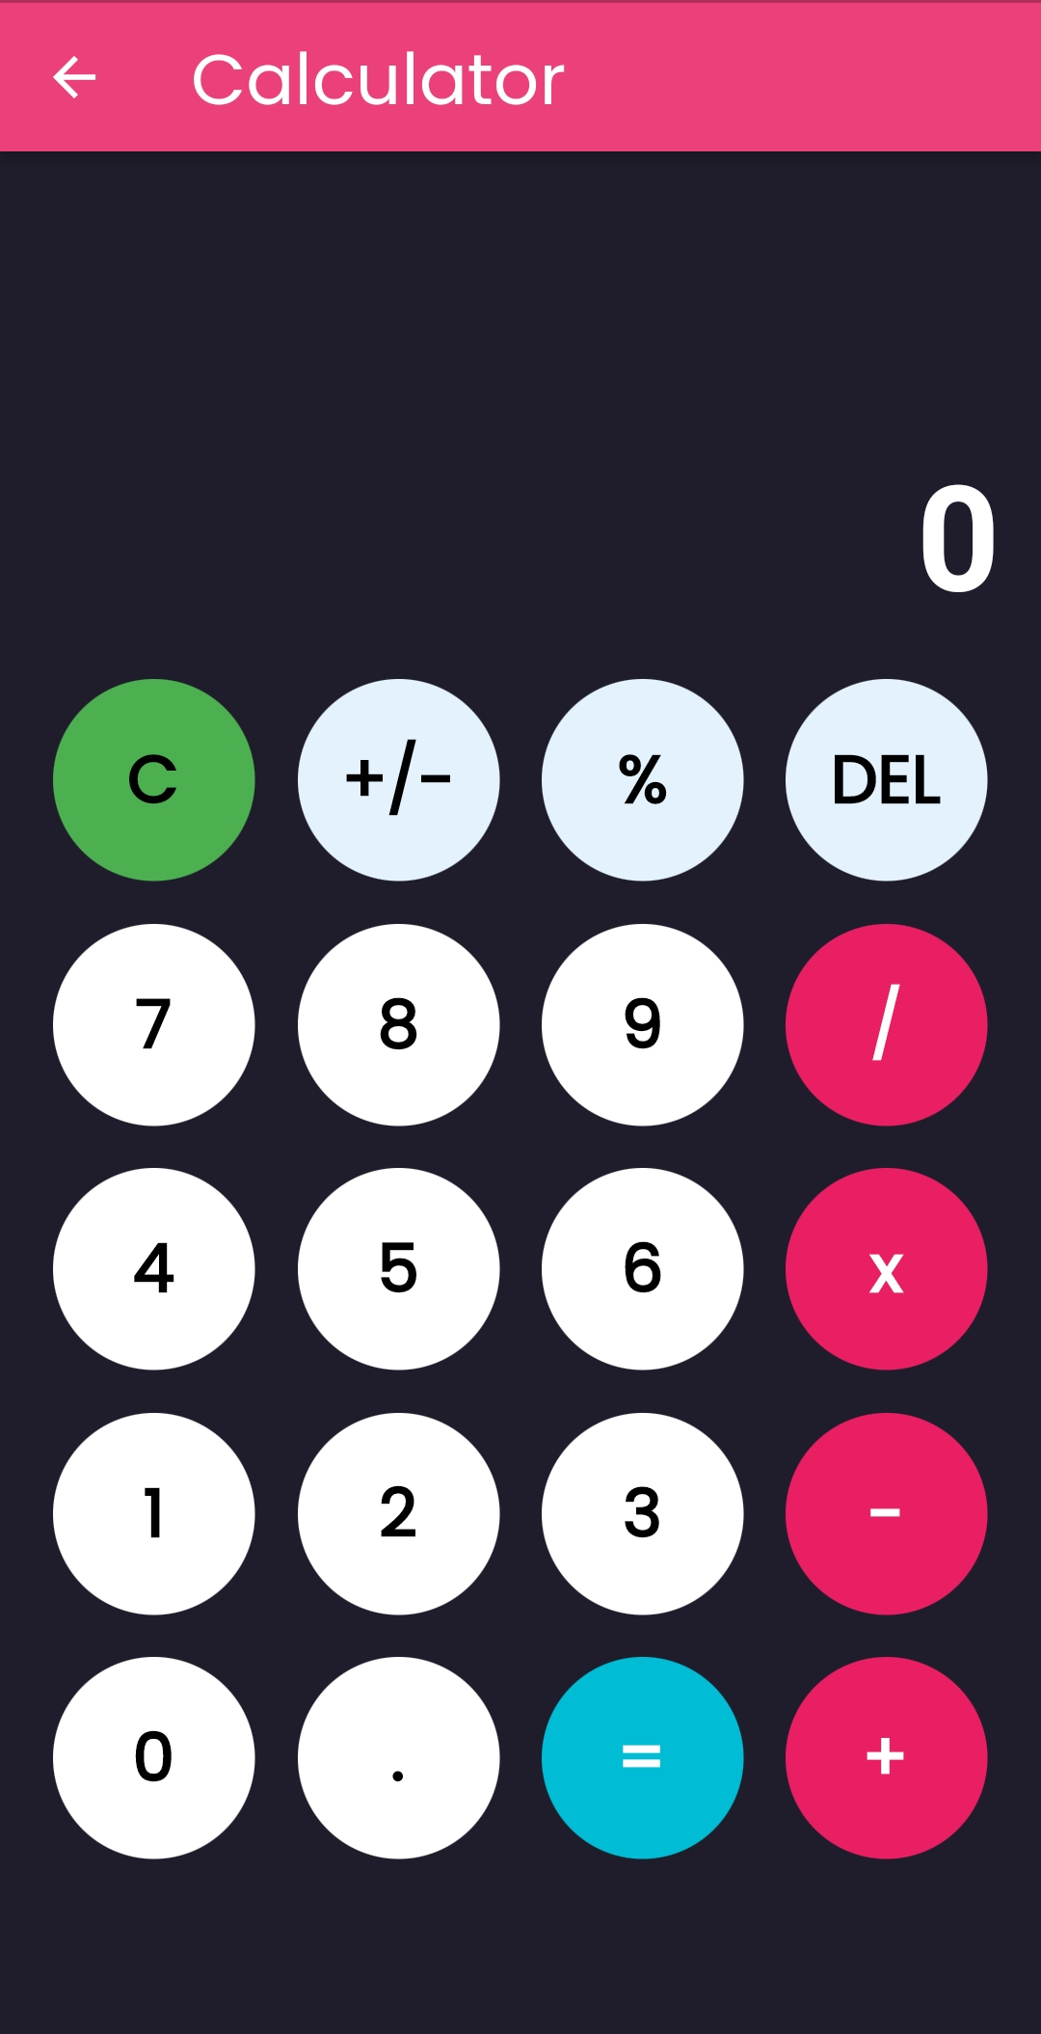
a) Title of the Project

Slide 16
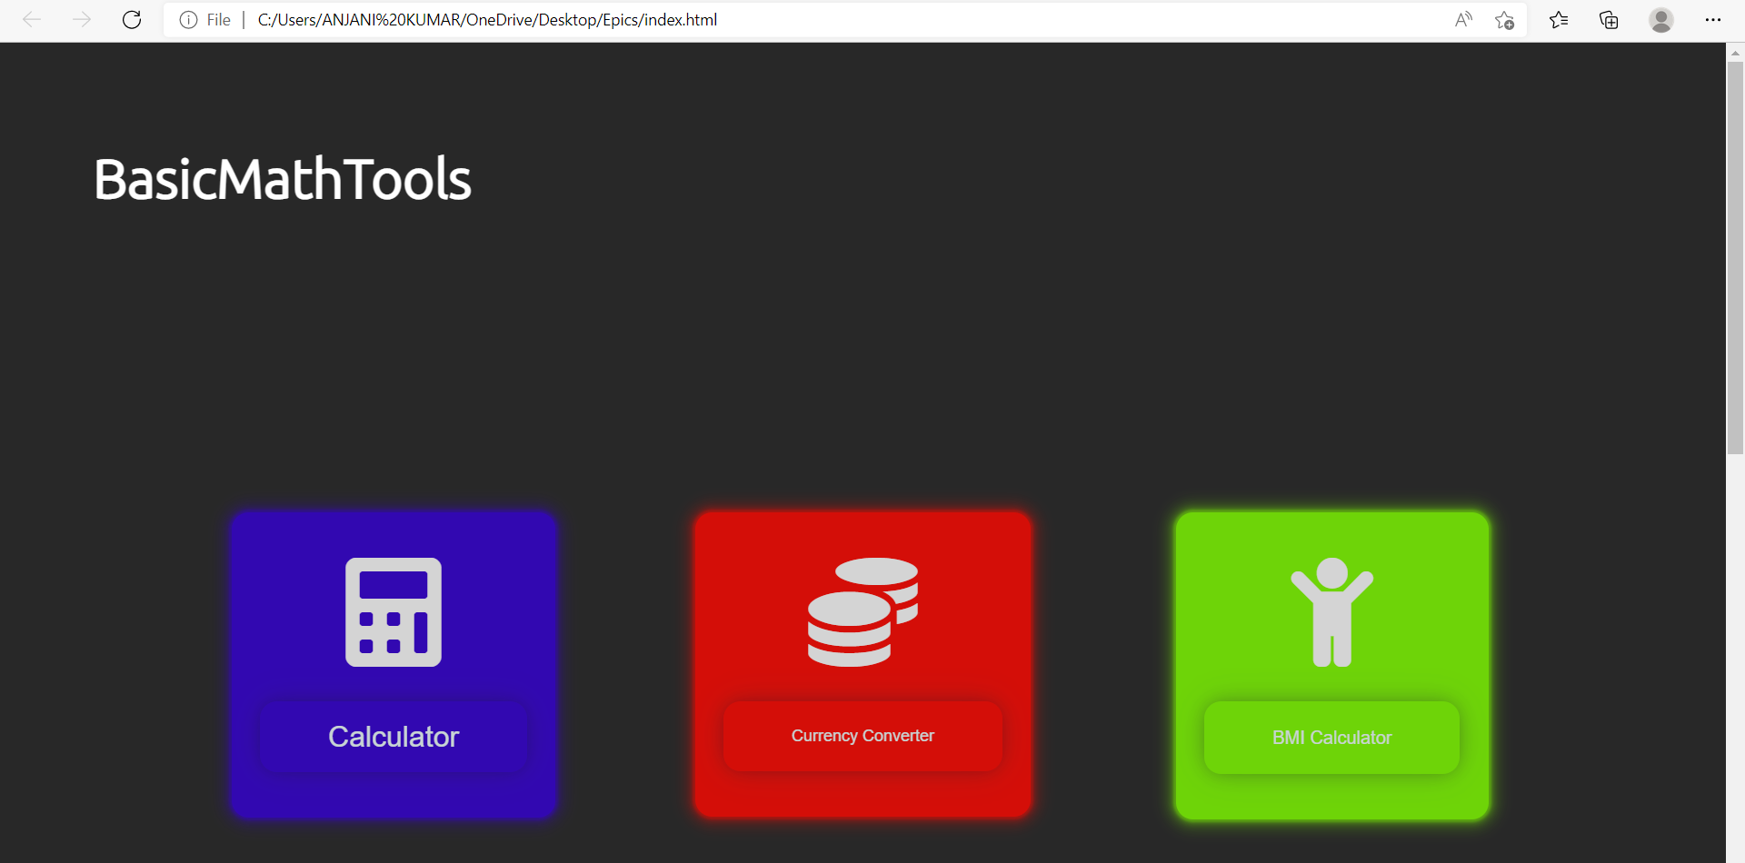
Screenshot - 3

Slide 17
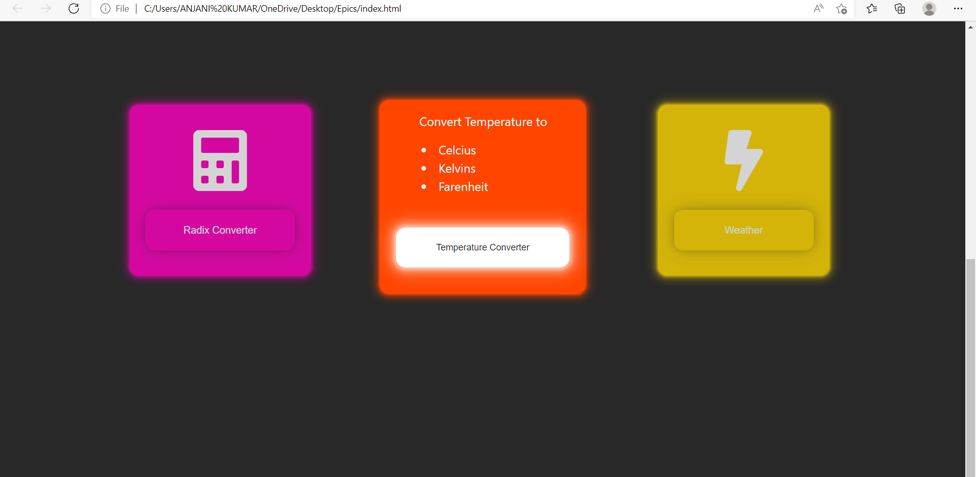
Screenshot - 4

Slide 18
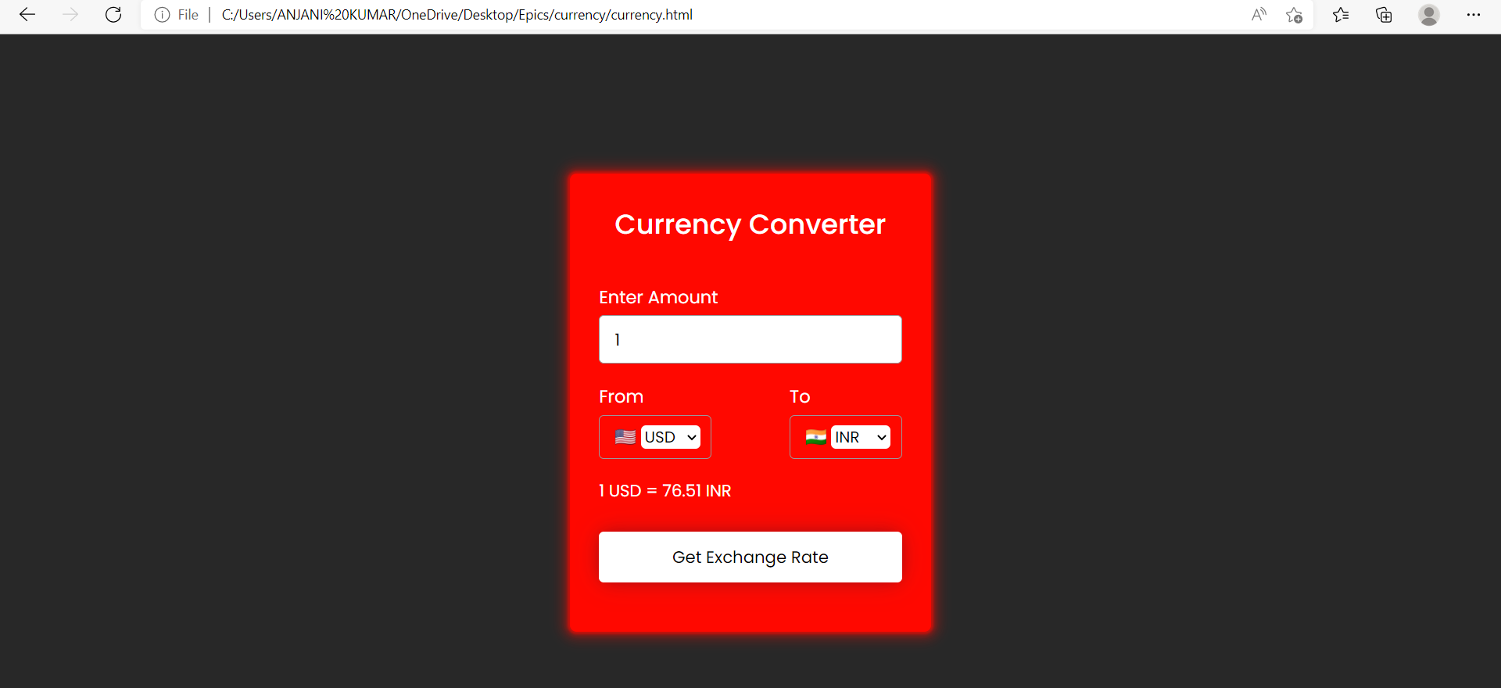
Screenshot - 5

Slide 19
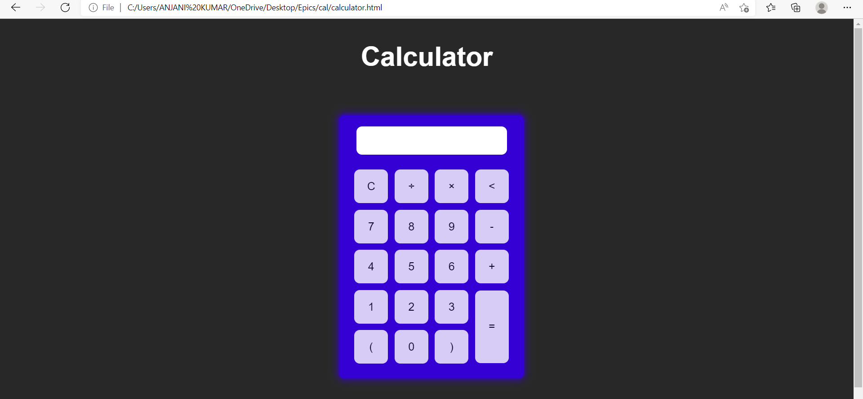
Screenshot - 6

Slide 20
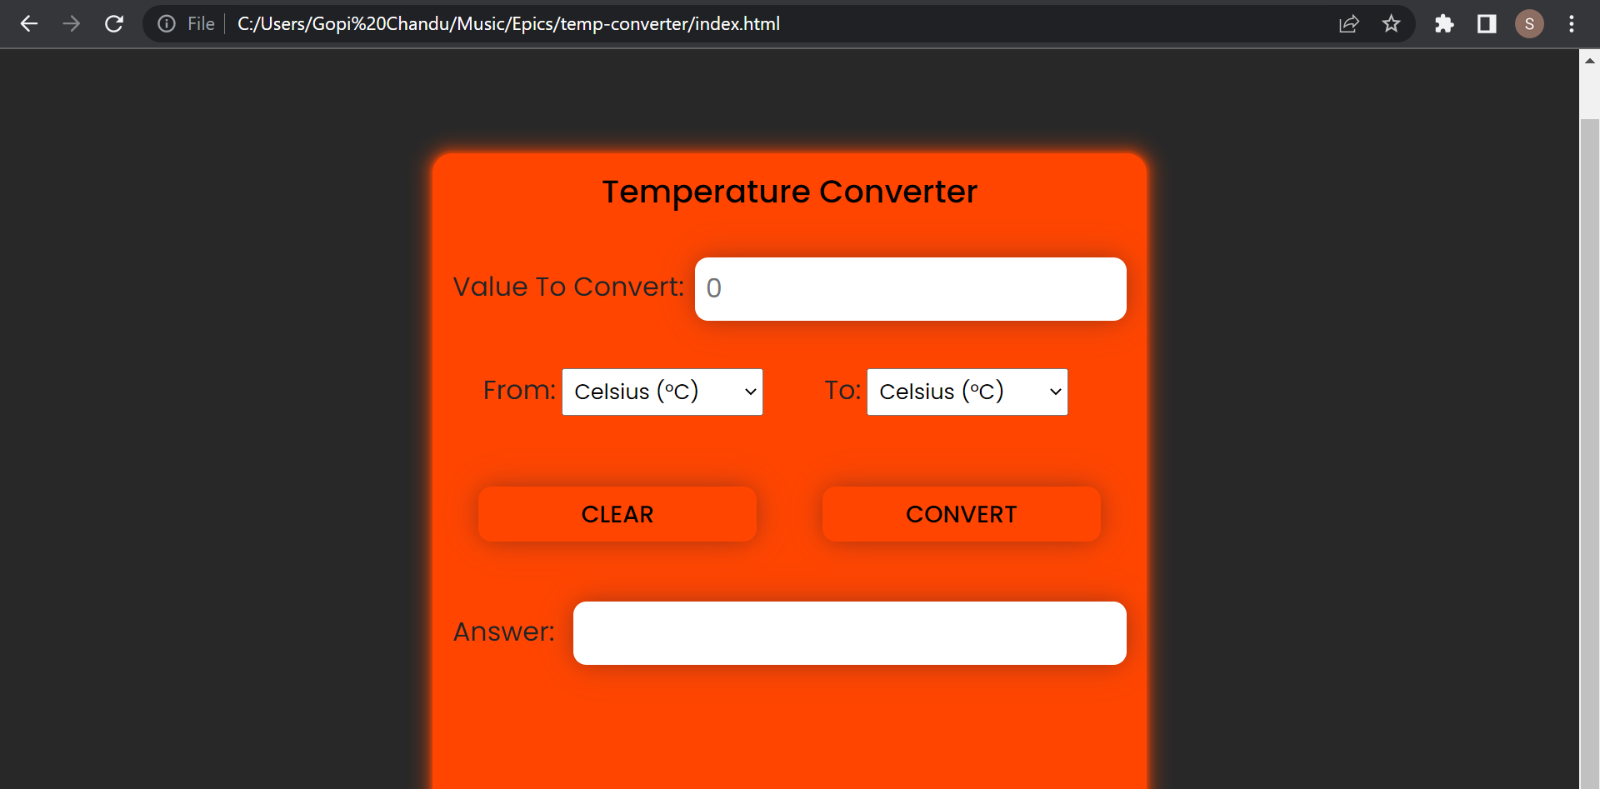
Screenshot - 7

Slide 21
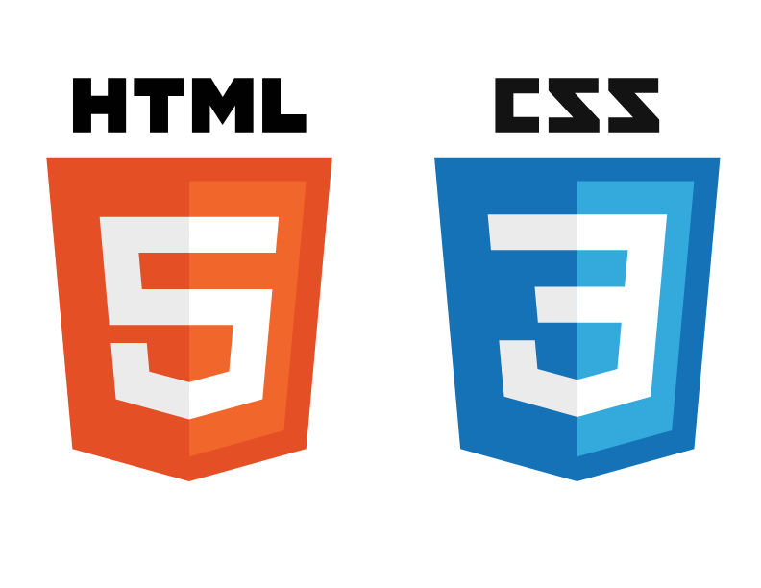

Languages used to build such elegant Website :
Languages used to build such elegant Website :

Slide 22

Frameworks Used:
Frameworks Used:

Slide 23


Language , Framework used to build the App
Language , Framework used to build the App

Slide 24
Thank you for watching till the end !
Thank you for watching till the end !

